Slide 1

CHURN PREDICTION.
Using Python
Presented By:
G. Vindhya
- 21641A6762
01

Slide 2
02
1
Abstract
2
Introduction
3
Software Requirements
INDEX
4
Hardware requirements
5
Proposed System
6
Advantages
7
Conclusion

Slide 3
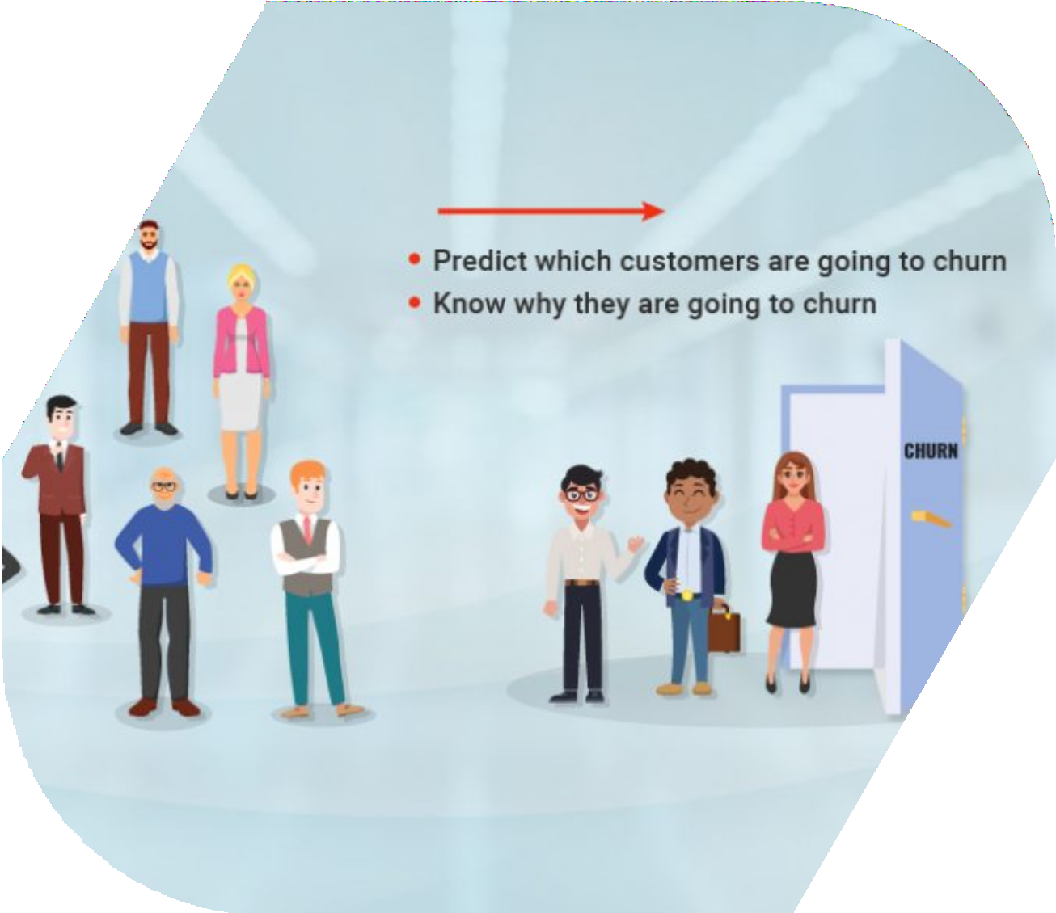
ABSTRACT
Customer churn is the phenomenon in which a client stops doing business with an entity. Users can stop using a company’s product or service for a variety of reasons, such as affordability, dissatisfaction with the offering, and bad customer service.
More often than not, customers who churn from one company will start doing business with their competitor.
03

Slide 4
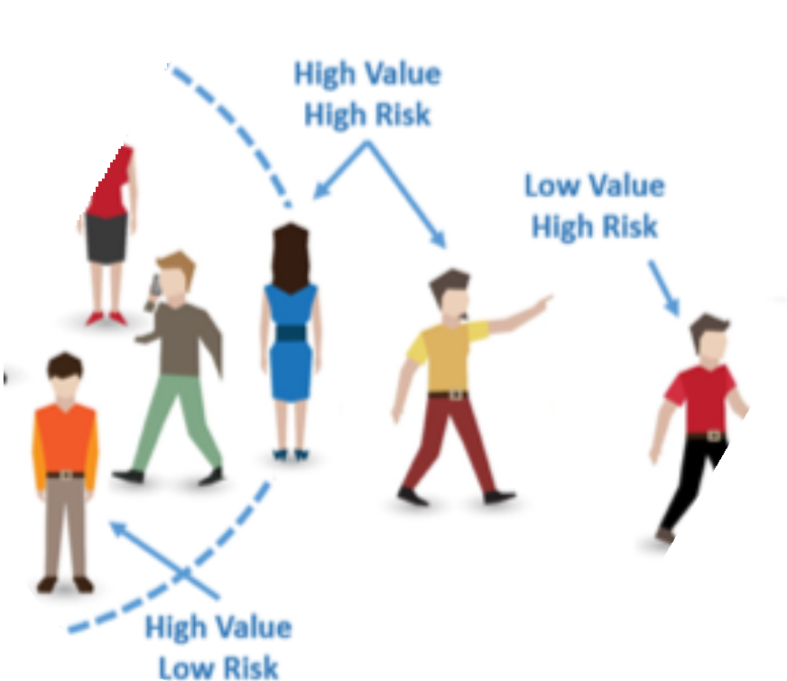
INTRODUCTION
Customer churn prediction is one of the most popular use cases of data science in marketing. Companies incur a lot of costs when users churn since it is expensive to replace an existing customer. Due to this, most mid to large-sized organizations will have some sort of churn prediction mechanism in place.
The act of churning isn’t one that happens suddenly. If you experience low network bandwidth, you are likely to tolerate it for a month or two. During this period, you would probably contact customer support, check your network speed, and leave a review on social media expressing your dissatisfaction.
04

Slide 5

Software Requirements
Python programming My SQL
05

Slide 6
Hardware Requirements
OS : Windows 10 or above Processor : Intel P-IV System RAM : 8GB
Hard Disk : 512 SSD or HDD
06

Slide 7
PROPOSED SYSTEM
For subscription-based companies like Netflix and Spotify, it is crucial to retain existing customers since the entire business model relies on plan renewals. If you would like to work as a data scientist for companies like these in the future, it is a good idea to learn about techniques such as customer churn prediction.
You can build a churn prediction model and showcase it on your resume, as this is a use case that is relevant to almost every organization and will help your portfolio stand out amongst other data science candidates.
07

Slide 8

Identify at risk customers. Defining the problem and goal.
Identify the methods to implement. Communications and sentiments fluctuations.
Create growth oppurtunities.
ADVANTAGES

Slide 9
CONCLUSION
After completing this project ,We have come to know that we stop churning employees from one company to another and solves the queries what the employees have.
09

Slide 10
Thanking
You

